Slide 1
Chapter 1
Introduction: Defining the Role of Statistics in Business
Elsevier/Academic Press
© Andrew F. Siegel, 2016

Slide 2
Statistics
Art and Science of Collecting and Understanding DATA:
  DATA = Recorded Information
    e.g., Sales, Productivity, Quality, Costs, Return, …
Why? Because you want:
  Best use of imperfect information:
    e.g., 50,000 customers, 1,600 workers, 386,000 transactions,…
  Good decisions in uncertain conditions:
    e.g., new product launch: Fail? OK? Make you rich?
  Competitive Edge
    e.g., for you and your business!
Elsevier/Academic Press
© Andrew F. Siegel, 2016

Slide 3
Quotes About Statistics
Wall Street Journal:
  "More CFOs say they want people who have initiative and can do things like analyze data and present their findings coherently ..."
  The company sells some of the data it gathers from credit- and debit-card transactions to investors and research firms, which mine the information for clues about trends that can move stock prices. ...
Advertising Age:
  A change in the role of corporate chief marketing officers (CMO) is considered in which the mining and analysis of data on consumer preferences behavior has become the most essential task in managing marketing. ...
  Sources: p. B7 of The Wall Street Journal, May 19, 2015; p. A1 of The Wall Street Journal, August 7, 2015; p. 2 of Advertising Age, February 13, 2012
Elsevier/Academic Press
© Andrew F. Siegel, 2016

Slide 4
Activities of Statistics
1. Designing the study:
  First step
  Plan for data-gathering
  Random sample (control bias and error)
2. Exploring the data:
  First step (once you have data)
  Look at, describe, summarize the data
  Are you on the right track?
Elsevier/Academic Press
© Andrew F. Siegel, 2016

Slide 5
Activities of Statistics (continued)
3. Modeling the data
  A framework of assumptions and equations
  Parameters represent important aspects of the data
  Helps with estimation and hypothesis testing
4. Estimating an unknown:
  Best “guess” based on data
  Wrong - but by how much?
  Confidence interval - “we’re 95% sure that the unknown is between …”
Elsevier/Academic Press
© Andrew F. Siegel, 2016

Slide 6
Activities of Statistics (continued)
5. Hypothesis testing:
  Data decide between two possibilities
  Does “it” really work? [or is “it” just randomly better?]
  Is financial statement correct? [or is error material?]
  Whiter, brighter wash?
  Is the difference statistically significant?
Elsevier/Academic Press
© Andrew F. Siegel, 2016

Slide 7
Data Mining
Search for patterns in large data sets
  Businesses data: marketing, finance, production ...
    Collected for some purpose, often useful for others
    From government or private companies
  Makes use of
    Statistics – all the basic activities, and
      Prediction, classification, clustering
    Computer science – efficient algorithms (instructions) for
      Collecting, maintaining, organizing, analyzing data
    Optimization – calculations to achieve a goal
      Maximize or minimize (e.g. sales or costs)
Elsevier/Academic Press
© Andrew F. Siegel, 2016

Slide 8
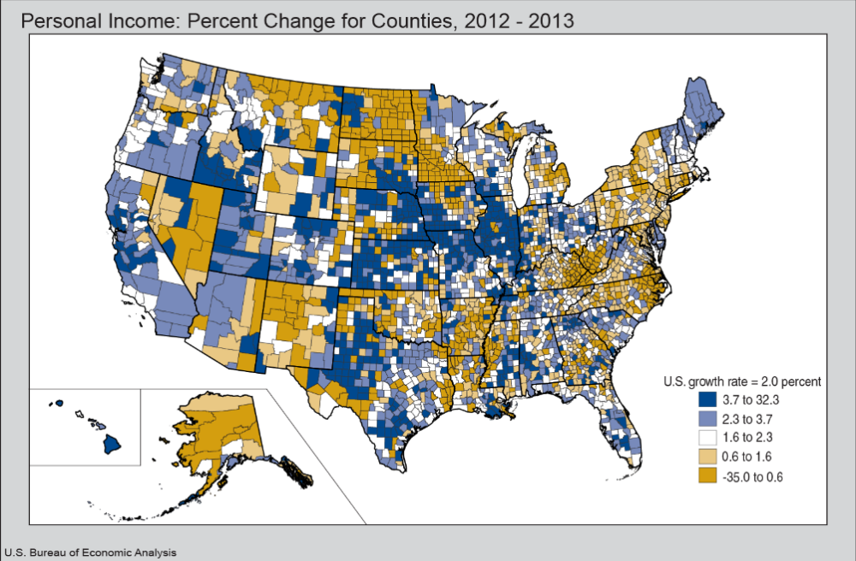
Census Bureau County Data
Over 3,000 counties with demographic, social, economic, and housing data available for mining
Elsevier/Academic Press
© Andrew F. Siegel, 2016

Slide 9
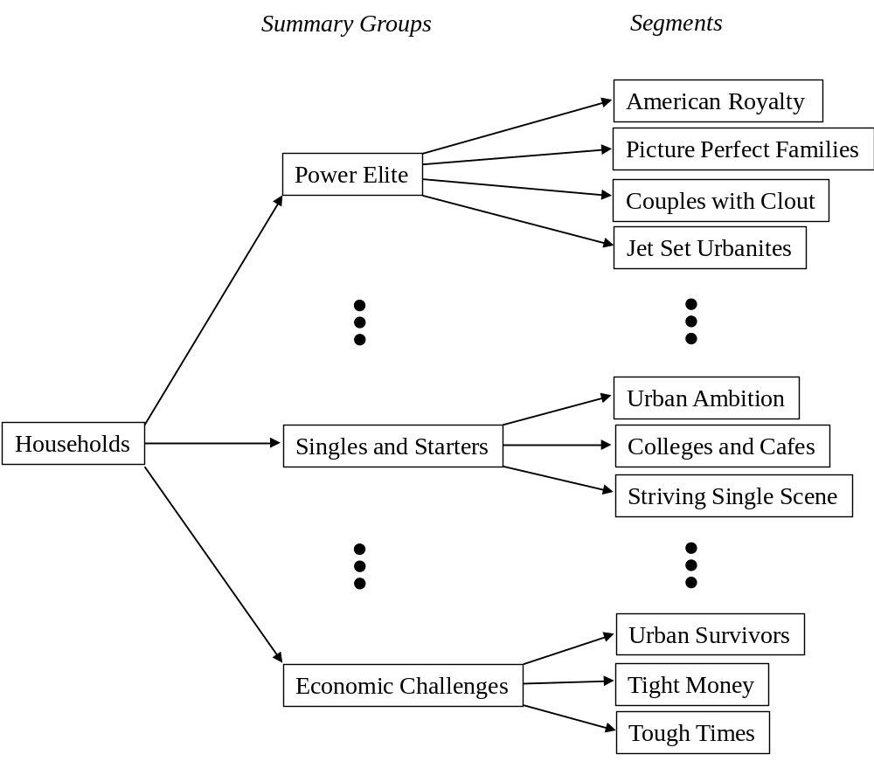
Clusters of Households
Identified through data mining (Mosaic® system from Experian)
Elsevier/Academic Press
© Andrew F. Siegel, 2016

Slide 10
Probability
“Inverse” of statistics
  Statistics: generalizes from data to the world
  Probability: “What if …” Assuming you know how the world works, what data are you likely to see?
Examples of probability:
  Flip coin, stock market, future sales, IRS audit, …
Foundation for statistical inference
Statistics
The
world
You
see
Probability
Elsevier/Academic Press
© Andrew F. Siegel, 2016

Slide 11
Statistical View of the World
Data are imperfect
  We do the best we can -- Statistics helps!
Events are random
  Can’t be right 100% of the time
Use statistical methods
  Along with common sense and good judgment
Be skeptical!
  Statistics can be used to support contradictory conclusions
  Look at who funded the study?
Elsevier/Academic Press
© Andrew F. Siegel, 2016

Slide 12
Statistics in Business: Examples
Advertising
  Effective? Which commercial? Which markets?
Quality control
  Defect rate? Cost? Are improvements working?
Finance
  Risk - How high? How to control? At what cost?
Accounting
  Audit to check financial statements. Is error material?
Other
  Economic forecasting, background info, measuring and controlling productivity (human and machine), …
Elsevier/Academic Press
© Andrew F. Siegel, 2016

